Slide 1
Trajectory Generation and Control for Quadrotors
__________________________________________________________________________________________
Sandesh Thapa
Department of Mechanical & Aerospace Engineering
Oklahoma State University

Slide 2
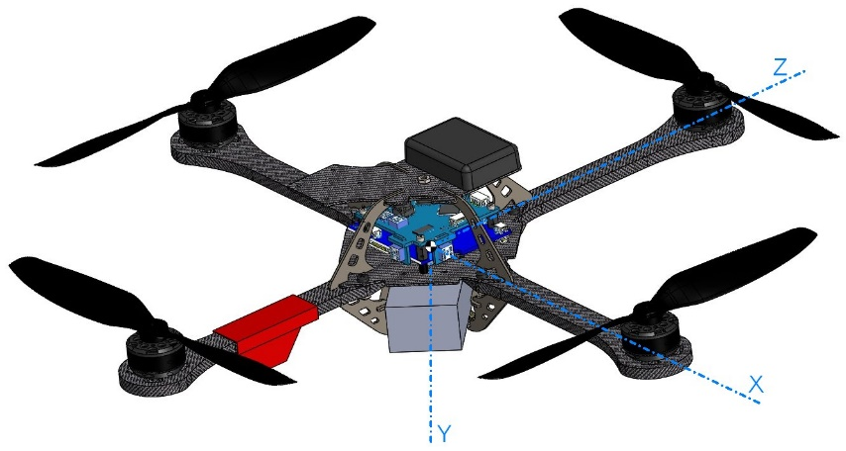
Introduction
Quadrotors are popular research because of their agility and mobility in 3D space
For a quadrotor maneuvering in tightly constraint environment, it is necessary to develop optimal trajectories to ensure safe passage through corridors and constraints [1].
Develop flight plans that leverage the dynamics of system [1].
[1] Mellinger, Daniel, and Vijay Kumar. "Minimum snap trajectory generation and control for quadrotors." Robotics and Automation (ICRA), 2011 IEEE International Conference on. IEEE, 2011.
Image source: http://wiki.asctec.de/display/AR/CAD+Models

Slide 3
Objective
Review of control and trajectory generation for quadrotors [1].
Understand and implement differential flatness for trajectory generation
Examples code given at [2, 3].
Implement minimum snap trajectory and control for quadrotors based on flatness [1, 3].
[1] Mellinger, Daniel, and Vijay Kumar. "Minimum snap trajectory generation and control for quadrotors." Robotics and Automation (ICRA), 2011 IEEE International Conference on. IEEE, 2011.
[2] https://github.com/WenjinTao/Robotics--Coursera/tree/master/Robotics-Aerial_Robotics
[3] https://www.coursera.org/learn/robotics-flight

Slide 4
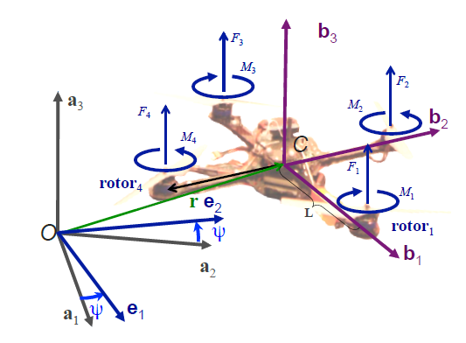
Dynamic Model
Angular velocity in body frame
r
Roll
Pitch
Yaw
Newton’s Equation of motion
u₁
u₂
Euler’s
Equation of motion
Source: N. Michael, D. Mellinger, Q. Lindsey, and V. Kumar, The GRASP Multiple Micro-UAV Testbed," IEEE Robotics and Automation Magazine, 2010.

Slide 5
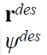
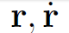
Control
Motor Controller
Rigid body Dynamics
Motor Controller
Rigid body Dynamics
Trajectory Planner
Position Controller
Trajectory Planner
Position Controller
Attitude Controller
Attitude Controller
commanded
actual (feedback)
specified
Source: N. Michael, D. Mellinger, Q. Lindsey, and V. Kumar, The GRASP Multiple Micro-UAV Testbed," IEEE Robotics and Automation Magazine, 2010.

Slide 6
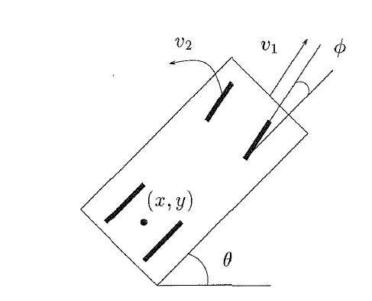
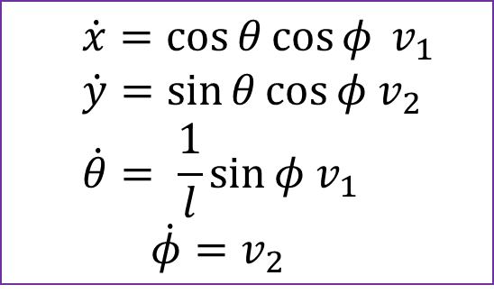
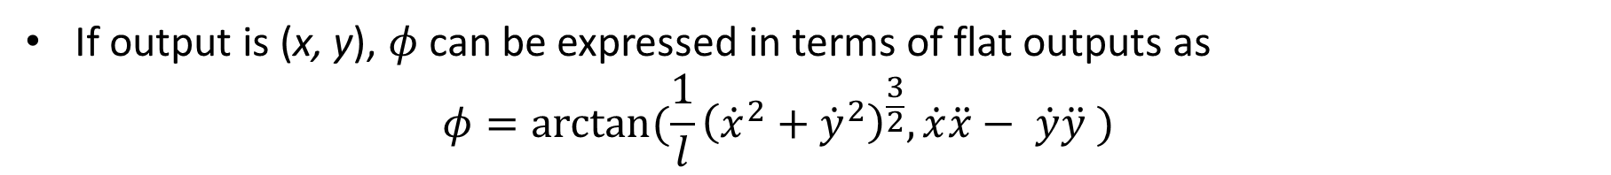
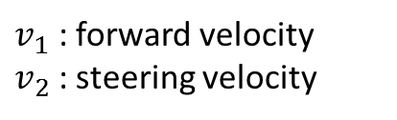
Differential Flatness
Definition: A non linear system is differentially flat if we can find a set of outputs such that we can express all states and inputs in terms of those outputs and their derivatives [1].
Example: Kinematic car
$$\dot{x}=\cos{θ}\cos{φ} v_{1}$$
$$\dot{y}=\sin{θ}\cos{φ v_{2}}$$
$$\dot{θ}= \frac{1}{l}\sin{φ v_{1}}$$
$$\dot{φ}=v_{2}$$
Equations of Motion
$v_{1}$ : forward velocity
$v_{2}$ : steering velocity
If output is (x, y), $φ$ can be expressed in terms of flat outputs as
$$φ=\arctan{(\frac{1}{l}{\left({\dot{x}}^{2}+{\dot{y}}^{2}\right)}^{\frac{3}{2}}, \dot{x}\ddot{x}− \dot{y}\ddot{y} )}$$
[1] M. J. Van Nieuwstadt and R. M. Murray, “Real-time trajectory generation for differentially flat systems,” International Journal of Robust and Nonlinear Control, vol. 8, pp. 995–1020, 1998

Slide 7
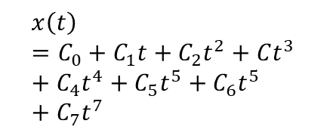
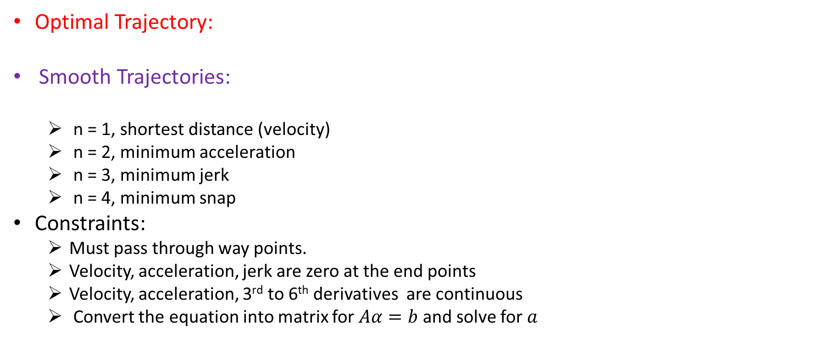
3D Trajectory Generation
Optimal Trajectory:
Smooth Trajectories:
n = 1, shortest distance (velocity)
n = 2, minimum acceleration
n = 3, minimum jerk
n = 4, minimum snap
Constraints:
Must pass through way points.
Velocity, acceleration, jerk are zero at the end points
Velocity, acceleration, 3rd to 6th derivatives are continuous
Convert the equation into matrix for $Aα=b$ and solve for $a$
L : functional
x
t
$$x\left(t\right)=C_{0}+C_{1}t+C_{2}t^{2}+Ct^{3}+C_{4}t^{4}+C_{5}t^{5}+C_{6}t^{5}+C_{7}t^{7}$$

Slide 8
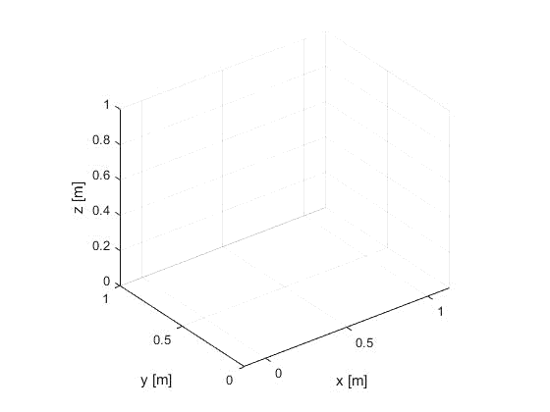
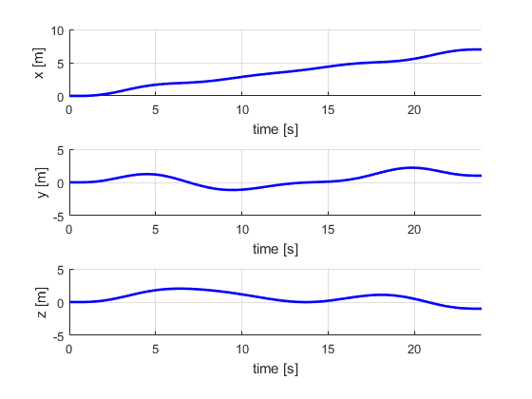
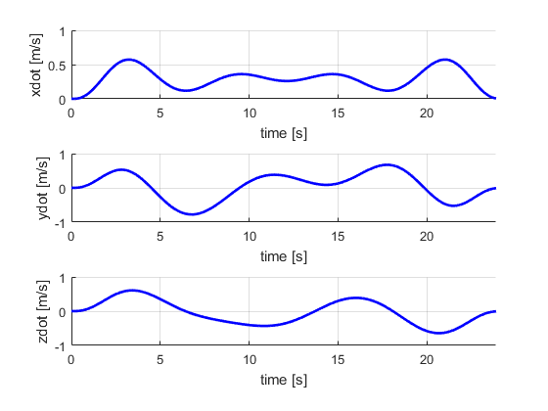
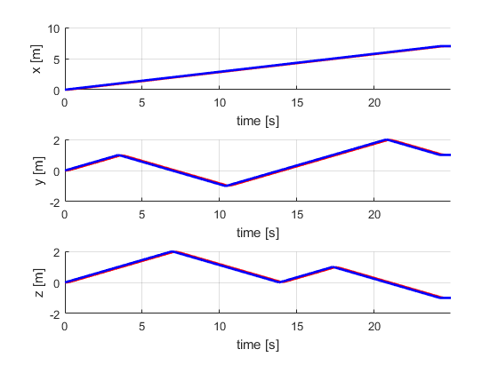
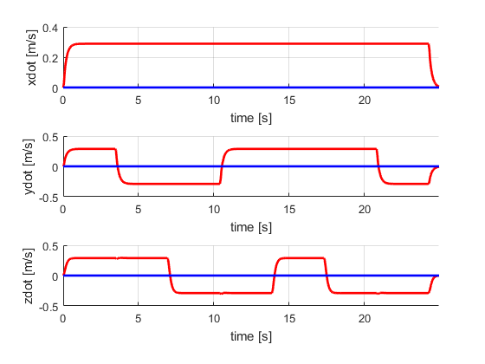
Simulation Results
Quad Position
Quad Velocity

Slide 9
Conclusion & Future Work
Implemented minimum snap trajectory and control for quadrotors
The trajectories are optimal
Can navigate based on ways points with smooth trajectories
Can be extended to motion planning for precise and aggressive maneuvers
Implement in experimental platform
If possible extend to multi-agents

Slide 10
Questions?

